Slide 1


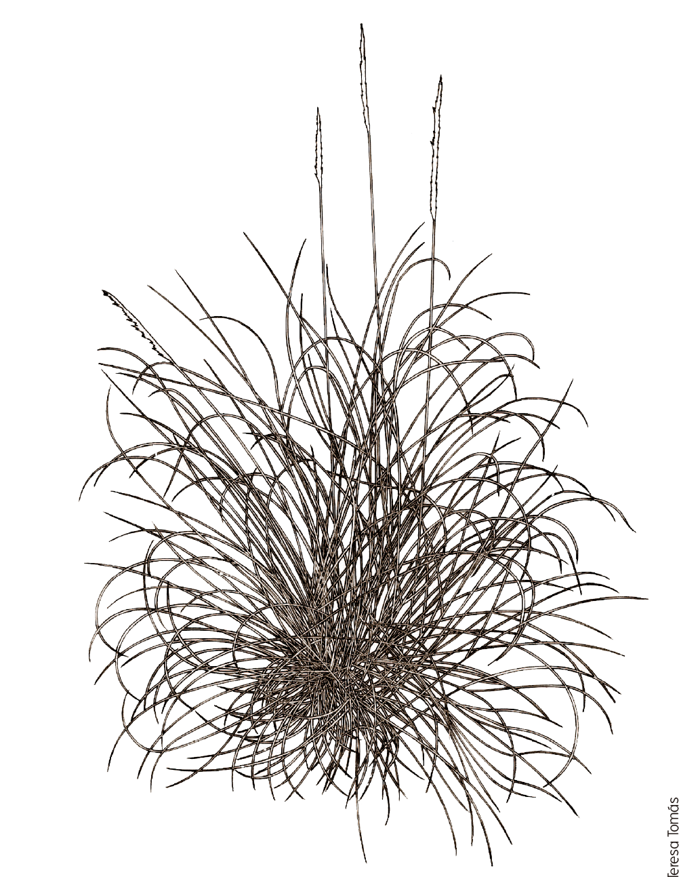

1 m²

Slide 2


Start Point
End Point

Slide 3
T₂
T₁
RN
RW
RE
RS

Slide 4
Treatments
G+C+
G-C+
G-C-
T₂
T₁
RN
RW
RE
RS

